Slide 1
Rae Anderson PLY
Disability Sports Australia
&
Cerebral Palsy Sporting and Recreational Association
Photos and slidedeck provided by DSA

Slide 2
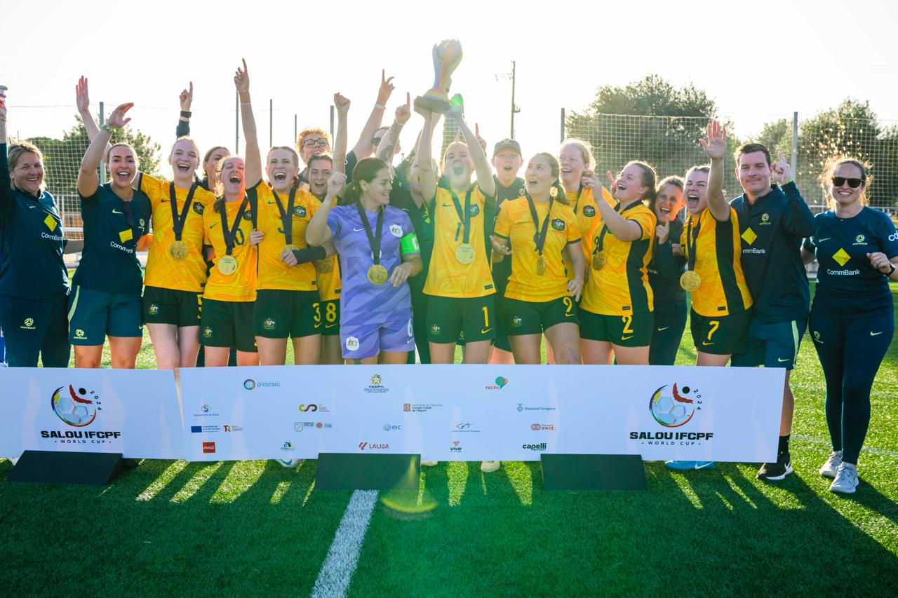
Background
Australia’s 7th Dual Summer Winter Paralympian (only 2nd Female)
Para Matilda World Cup Champions 2024
Notes:
How far can you go talk – achievements, goals, outcomes

Slide 3
My recent projects
Sport NSW Inclusive Practice Workshops across NSW
Sports Medicine Australias Adaptive First Aid methods consultant
National Health Guidelines consumer consulting
Hurlstone Womens Adaptive Football Program coach
PLC Transitions Special Olympics funded In-Schools program (multisports day)
Paralympics Australia
Paralympics Australia’s school presentation (Imagine Program)
Mentoring Program
DSA
Abilities Unleashed Sports Days (Kids & Adults)
DSA Inclusive Clubs Workshops
CPSARA
Cultural support with upcoming World Ability Sports Games, Jakarta - September
Connect Days
Mentoring Program
OSP funded future opportunities
Health Professional talks
Mentoring events
Thesis: Mediating Disability and Social Justice: A Cultural Analysis of Disability Representations in Contemporary Indonesia
FRANCE NEXT WEEK!!! SKIING WITH FRIENDS FROM AROUND THE WORLD
Notes:
Current and relevant projects

Slide 4
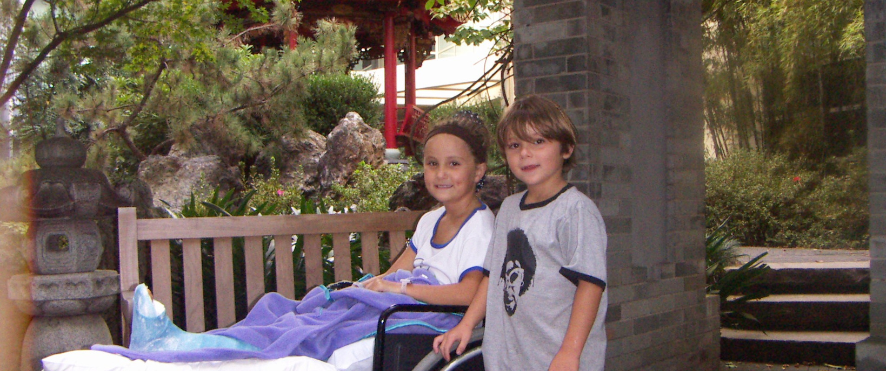
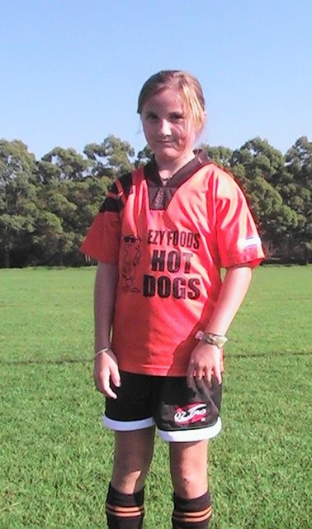
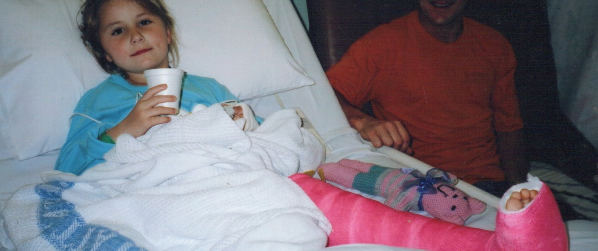
Rae Anderson - My Why
Notes:
Why I promote Para sport

Slide 5
About Disability Sports Australia
A charity and one of Australia's 9 National Sporting Organisations for people living with disabilities.
Our vision: Active lives for all Australians with disability.
Our mission: To enable more Australians with disability to be more active, more often.
At DSA, we aim to connect Australians with disability to local sport and recreation opportunities
Notes:
How I promote Para sport. Work with DSA, what they do

Slide 6
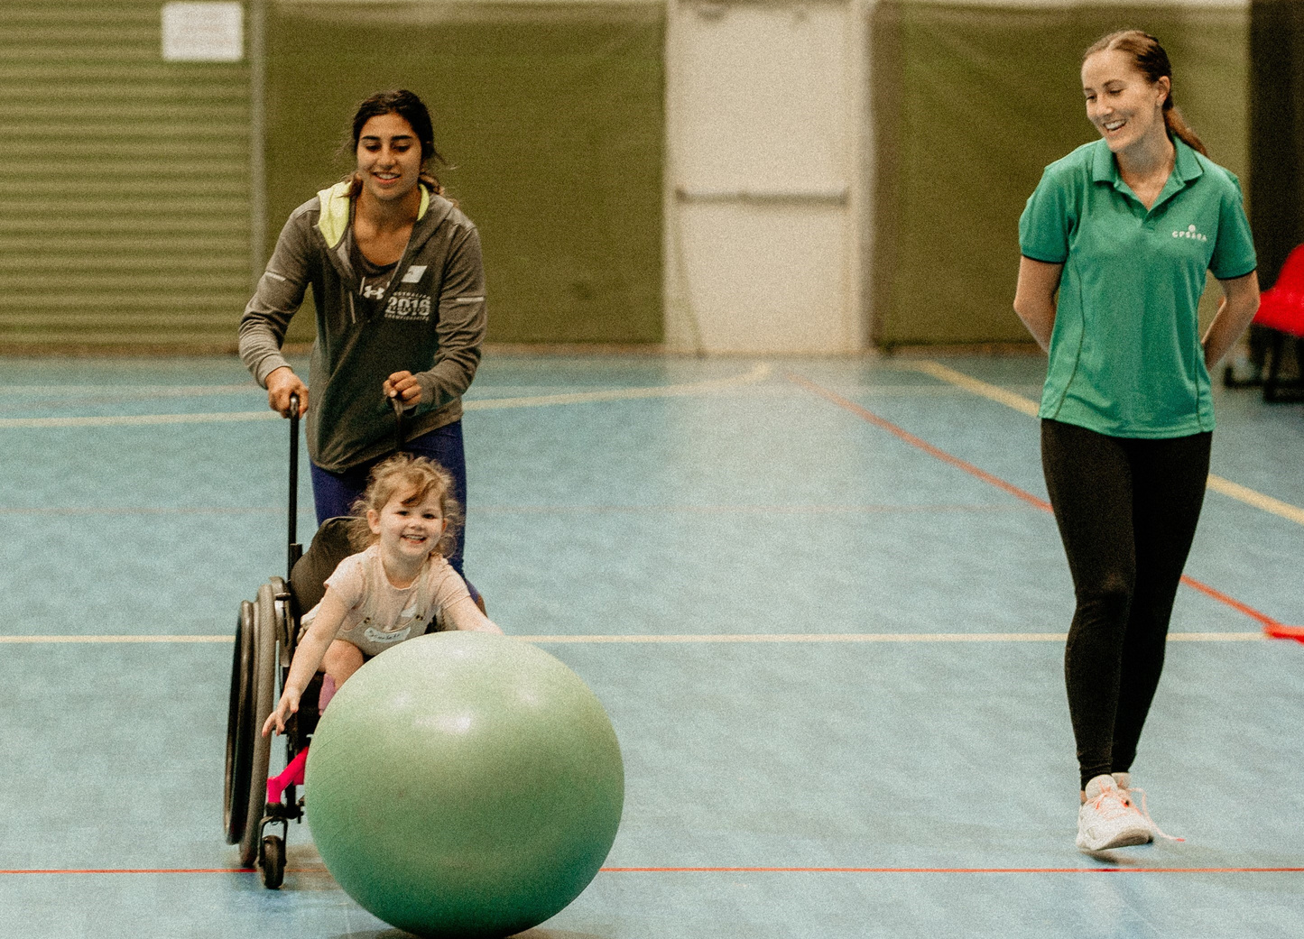
About CPSARA
A charity that functions as a state sporting disability organization and is a state member of DSA
Our mission: CPSARA aims to provide sporting and recreational opportunities for individuals with cerebral palsy and other neurological conditions, promoting participation and enjoyment.
CPSARA creates a community for athletes and their families to connect, share experiences, and support each other on their sporting journeys.
Notes:
How I promote Para sport. Work with CPSARA, what they do. Mention health professional membership, newsletters, mentoring programs, future opportunities for health professional workshops with OSP funding.

Slide 7
Barriers to Participation
1. Accessibility Issues
Lack of accessible facilities and venues
Inadequate transportation option
2. Personal Barriers
Low self-esteem and confidence
Fear of injury or further health complications
3. Training and Coaching
Shortage of trained coaches
Inadequate training on how to support people with disability
Lack of Active co-design
4. Limited Opportunities and programs
Scarcity of adaptive ports programs and competitions available
Understanding difference between modified sport vs disability specific sport
5. Lack of Awareness
Insufficient information about available program and opportunities
Lack of awareness within sporting organisations on how to include people with disability.
Early intervention from health professional suggestions etc
Notes:
DSA identified barriers to participation

Slide 8
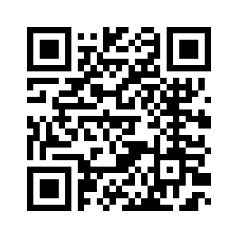
Accessibility Champion Course
www.sports.org.au/accessibility-champion
Notes:
Heaps of links on Promote PA, sometimes it can become overwhelming – one resource is ACC

Slide 9
What is the Accessibility Champion Course?
Free online user friendly module that was co-designed developed with the Australian Sports Commission.
The course is all about identifying, upskilling, and supporting grassroots sporting clubs and leisure providers to start their accessibility journey.
Some key learnings outcomes will be:
Removing the fear
Foundational understanding of disability
Simple steps to become a more accessible destination
The ground up approach to disability accessibility
Ongoing support through a bank of resources
Notes:
One relevant resource is the ACC. Aimed at sporting clubs but messaging is relevant

Slide 10
How can we support you?
Notes:
Accessibility Champion Course:
Aimed at clubs BUT can be used by anyone
Online resources after the event

Slide 11
Factors when promoting adaptive sport to families
No one size fits all
Think about ‘classification’ – Kerry to expand on
Not all kids become Olympians, just like all kids with disabilities won’t want to aim for Paralympics
Kids need options: Abilities Unleashed, Connect Days & Paralympics Australia Come & Try days create an opportunity to find ‘the right fit’ for each child
Abilities Unleashed – School hours program
Connect Days – Weekend event
Paralympics Australia Come & Try days – Weekday focus on high performance community networking
Notes:
What to think about as a health professional, coming from an athlete

Slide 12
Abilities Unleashed
Notes:
Events to find suitable local events

Slide 13
Abilities Unleashed
Notes:
Statistics from the event. Talk about outcomes from past 3 events // Pros and Cons of AUK

Slide 14
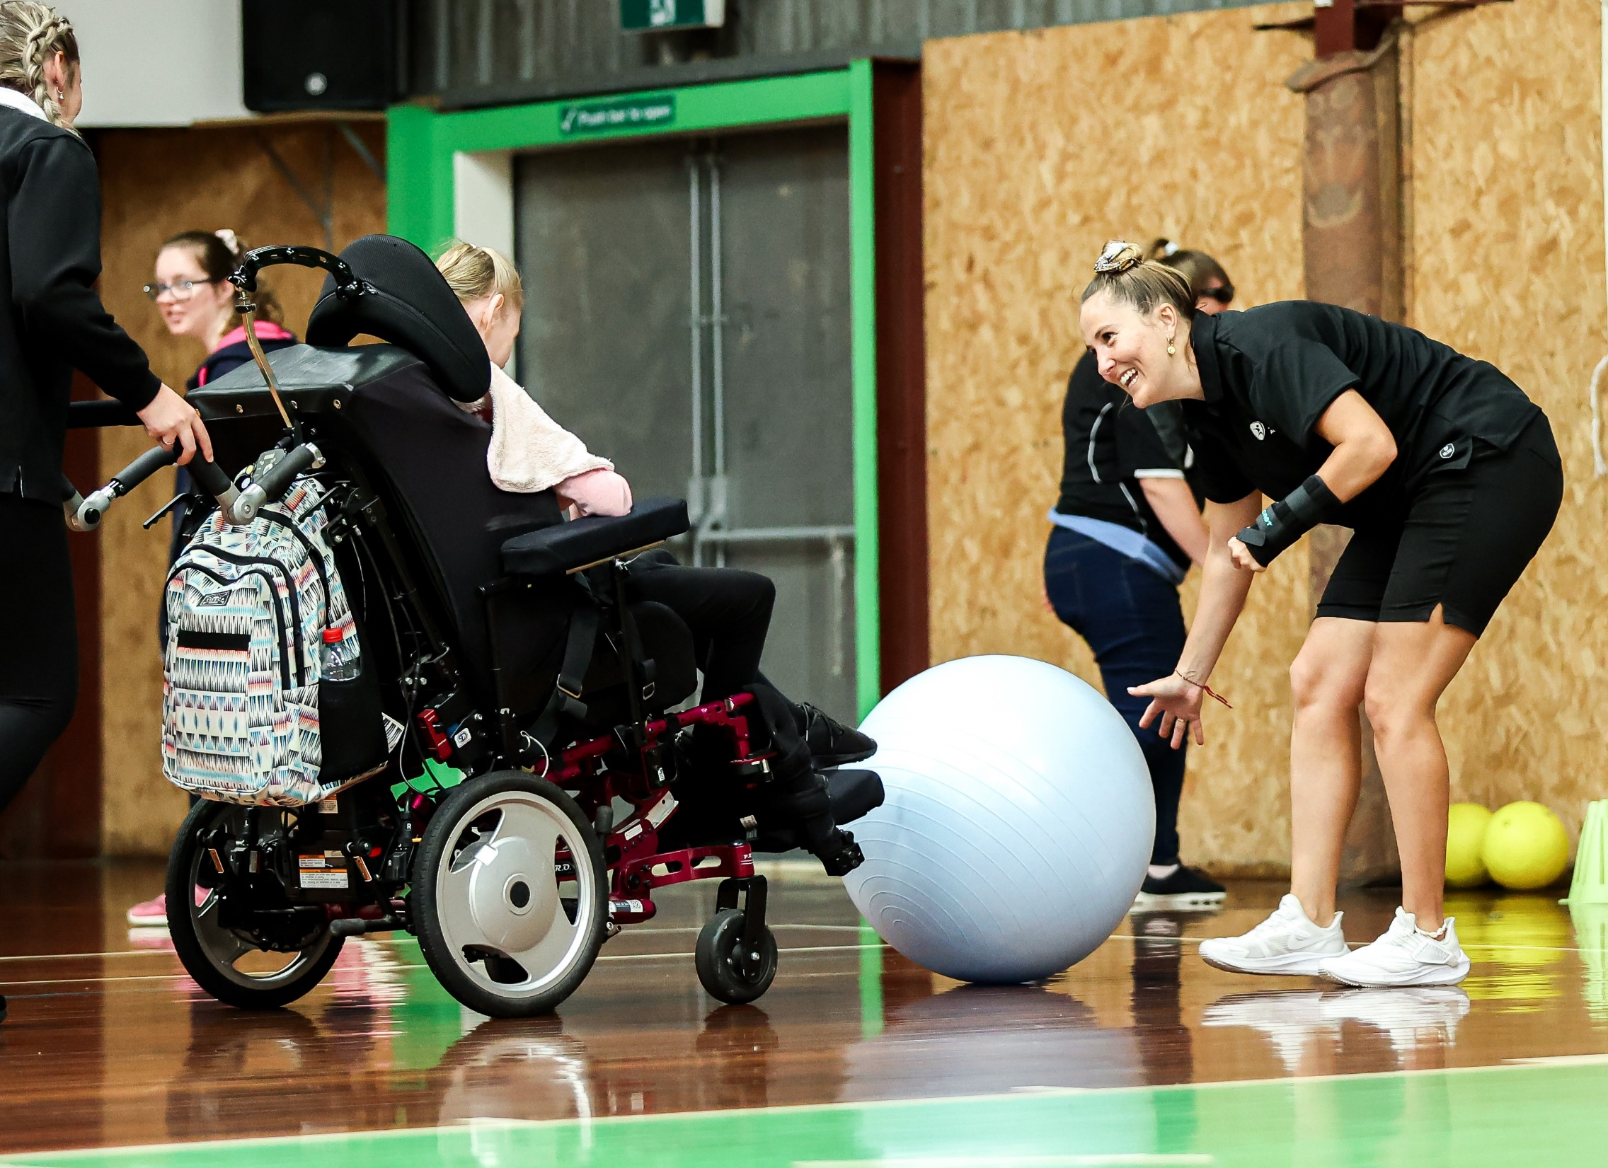
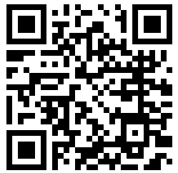
Abilities Unleashed
Find out more:
https://www.abilitiesunleashed.com.au/
Notes:
Upcoming AUK days and opportunities in Blacktown Centre. Mention volunteering opportunities

Slide 15
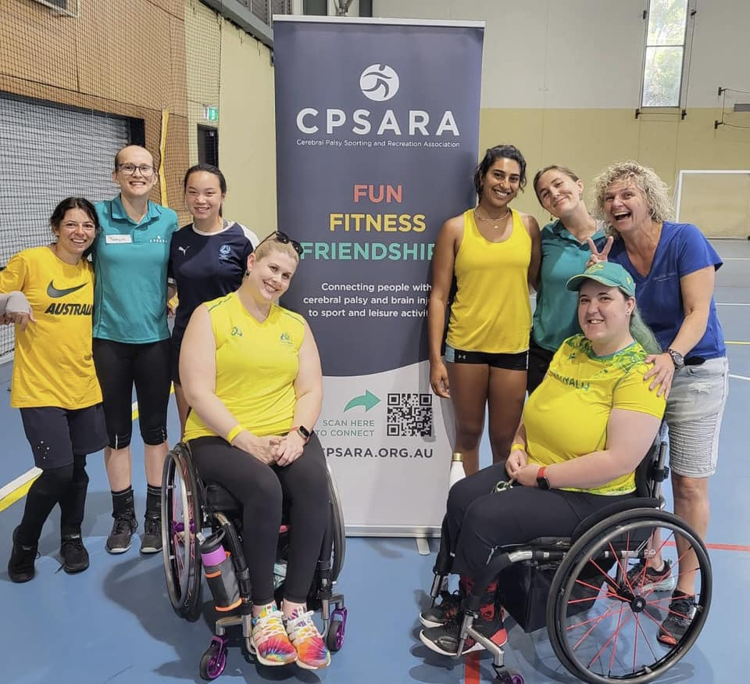
Connect Days
This FREE Multisport event is for people with any type of disability to try new sports and make new friends in a safe, fun and inclusive environment.
This day is a great opportunity to try sport for the first time or connect with other people with disabilities.
For CPSARA members, this is an opportunity to enjoy a great day out with your fellow members - try a new sport, make new friends and support participants new to sport too!
Notes:
Talk about outcomes of Connect Days

Slide 16
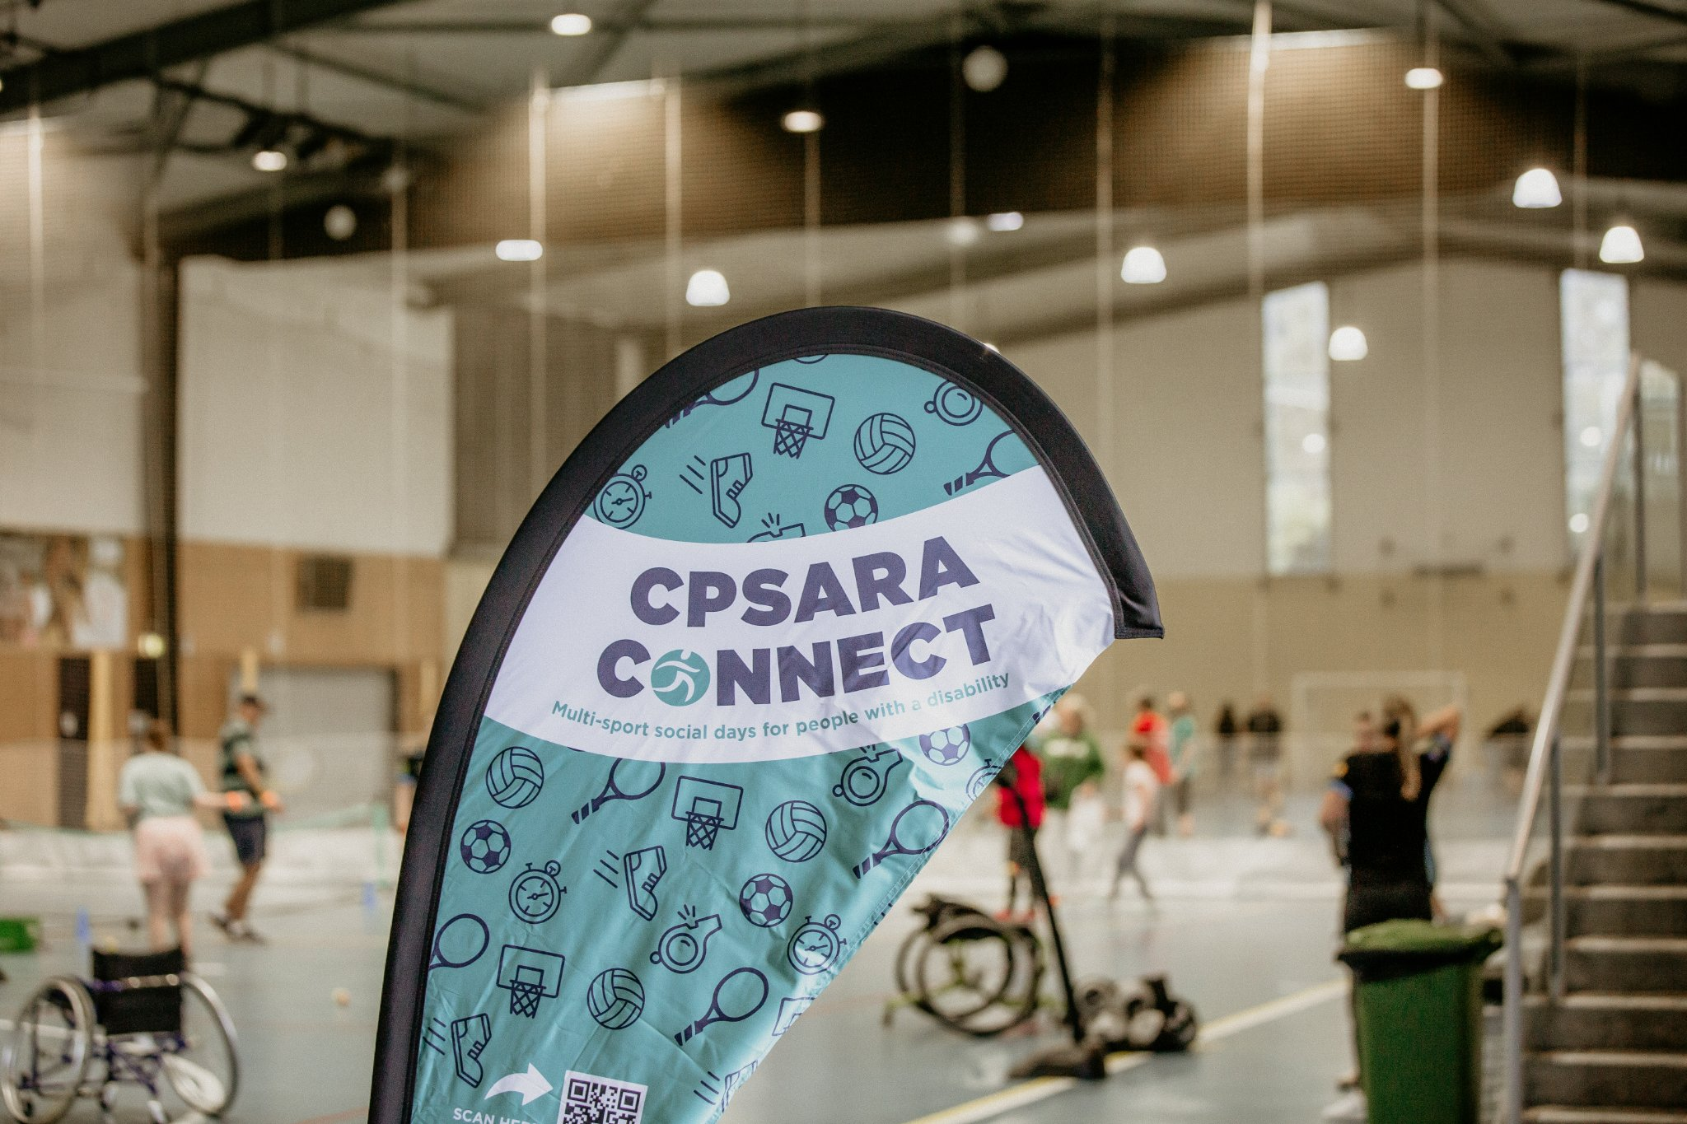
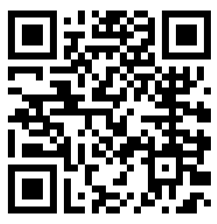
Connect Days
Find out more:
https://www.cpsara.org.au/upcomingevents
Notes:
Link to connect days, membership, etc. Health pros can become members, volunteer at the days// pros and cons of Connect Days and mention pros and cons of PA C&T days

Slide 17
Free Support
Follow social media:
@disabilitysportsaustralia
@cpsara_nsw
Health Professional become CPSARA members to:
Access monthly newsletters on upcoming opportunities for you and your patients
Volunteer at DSA and CPSARA days to learn about opportunities and adaptive ideas
Accessible Champions Course and Resources
Support with classification
Request team workshops for upskilling clinics on adaptive programs
Patients and their families become CPSARA members to:
Access monthly newsletters on upcoming opportunities
Access mentoring programs for parents and children
Attend events to meet similar families
Become part of a growing, supportive community
Mentoring support for Paralympic pathways AND recreational programs
State and National funding opportunities for representative sports
Notes:
Insta, Facebook, LinkedIn, TikTok

